Slide 1

Presentation of AIR POLLUTION on FRANKFURTER ALLEE In Berlin
A presentation made by Ben

Slide 2
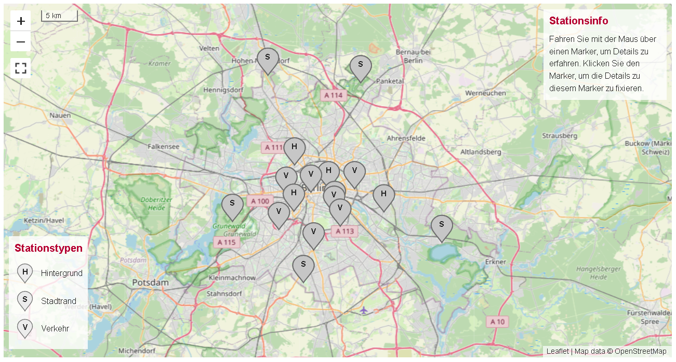
Overview of active measuring stations

Slide 3
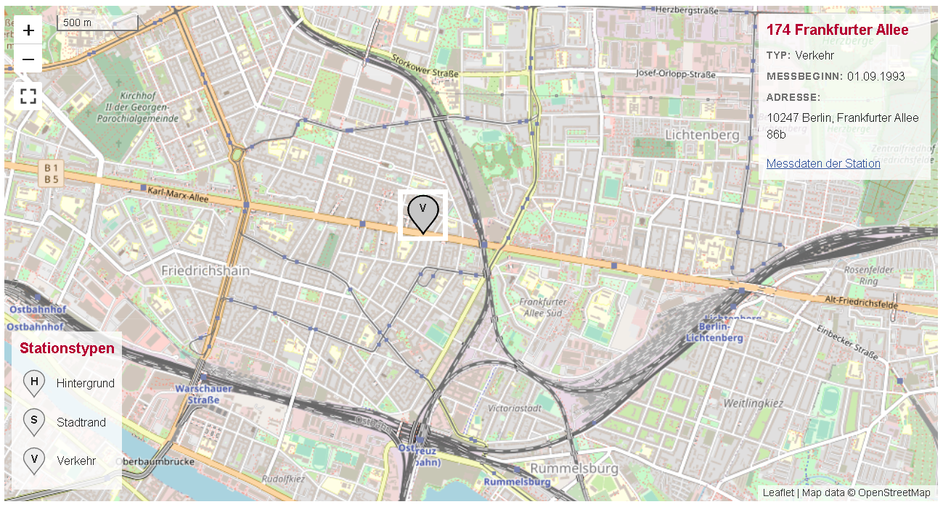
Station #174 Frankfurter Allee

Slide 4
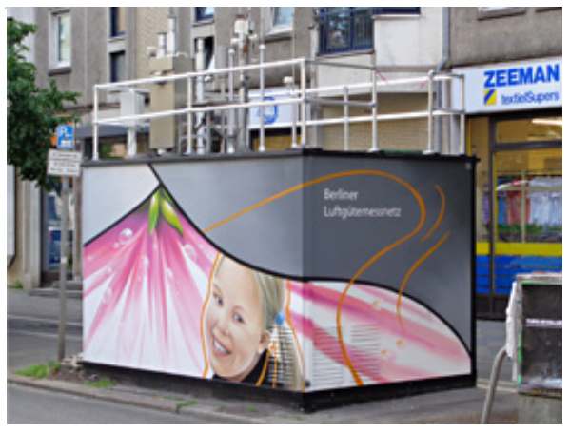
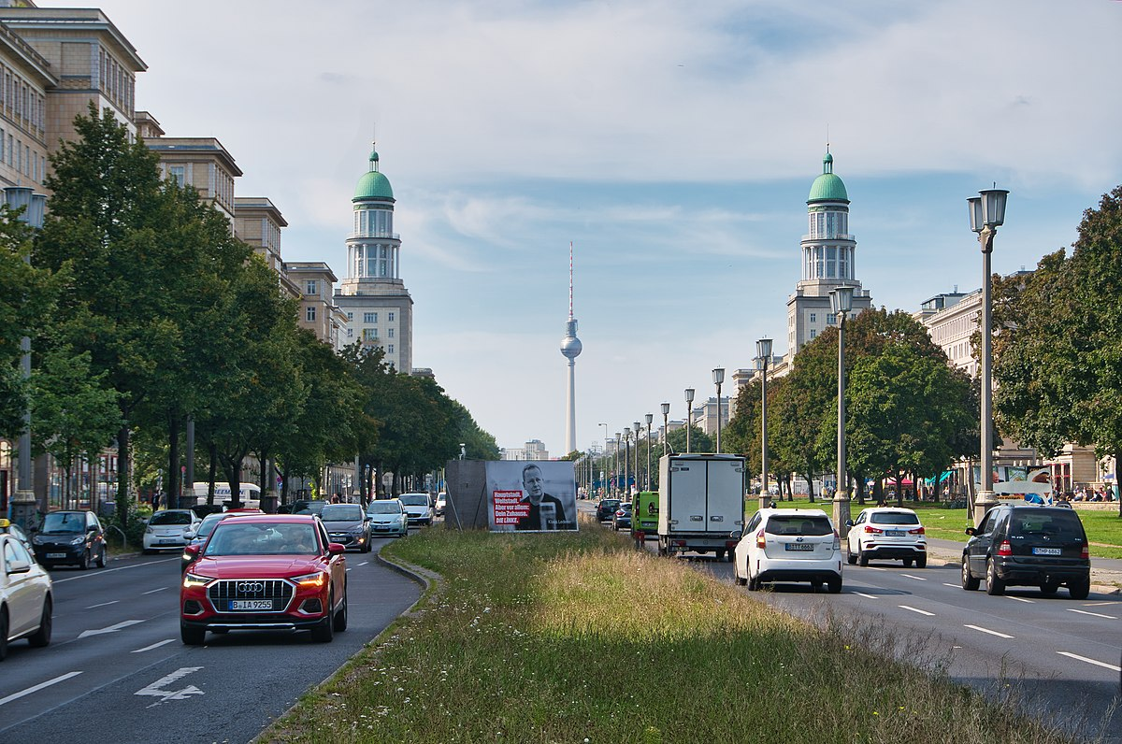
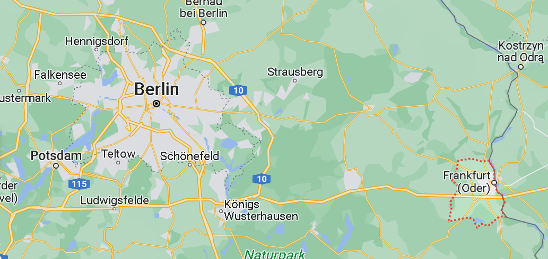
Station #174 Frankfurter Allee
Particulate air pollutants
Nitrogen Oxides (NOₓ)
Ozone (O₃)
Carbon Monoxide (CO)
Notes:
the station measures the following gases and particles

Slide 5
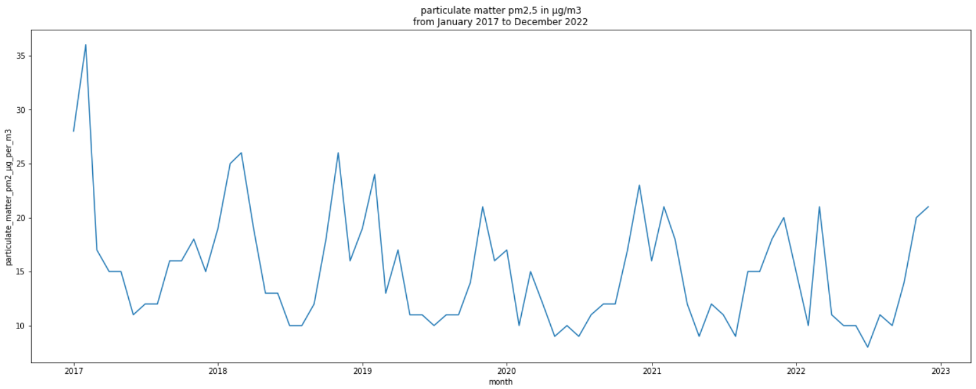
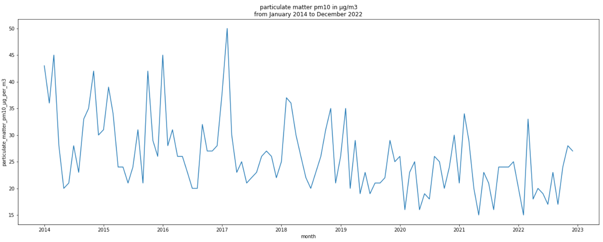
PM2,5
PM10
Notes:
you see that the values above a certain threshold decrease over the years
Next pollutants are nitrogen oxides

Slide 6
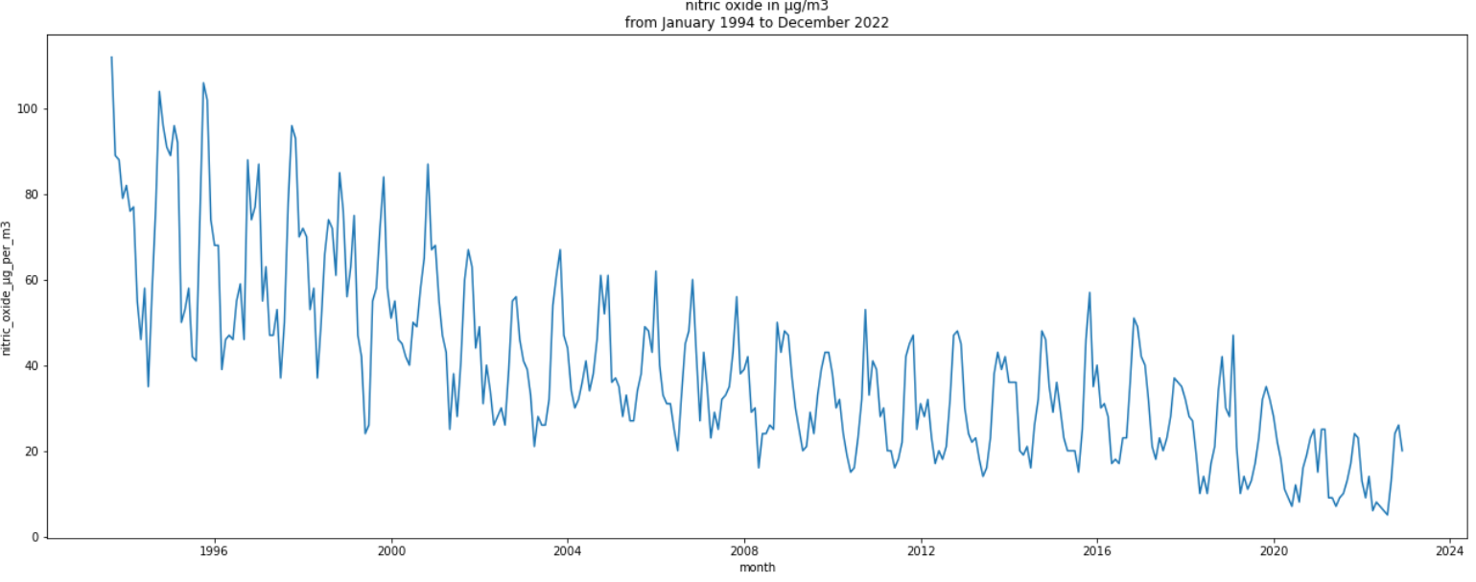
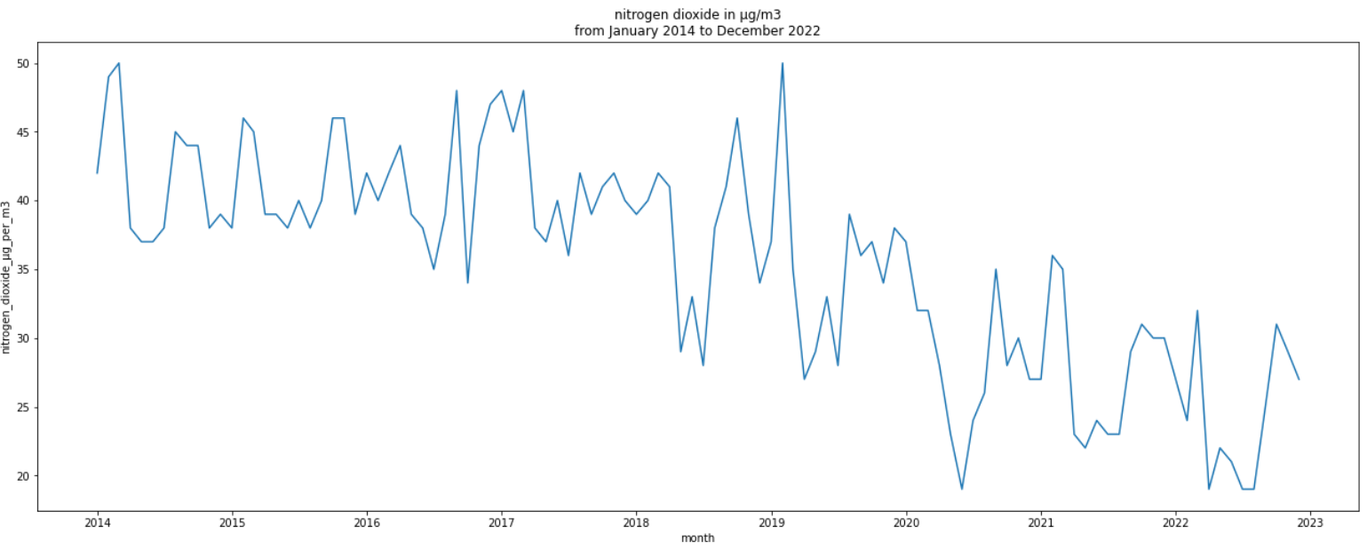
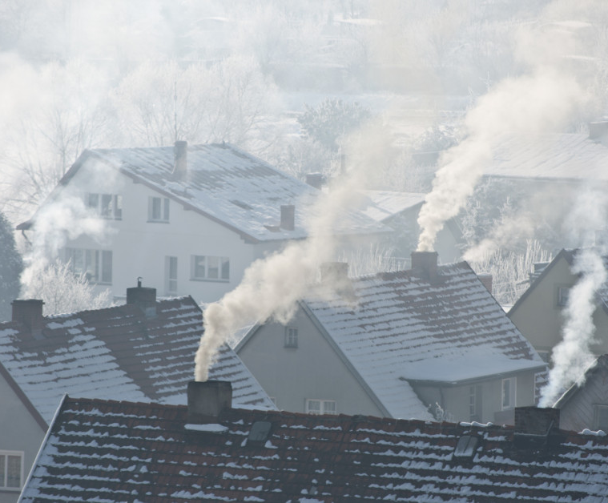

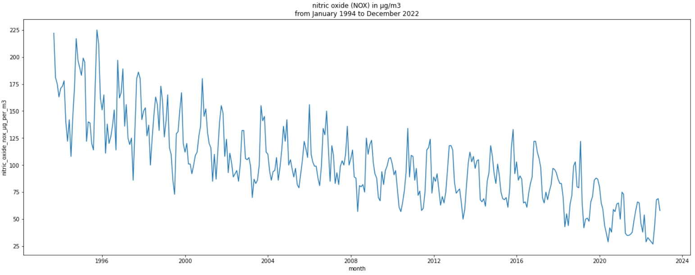
NO
NO₂
1994-2022
2014-2022
NO_{x}
1994-2022
Notes:
you can clearly see that the values have decreased over the years!
the next gas we consider is ozone

Slide 7
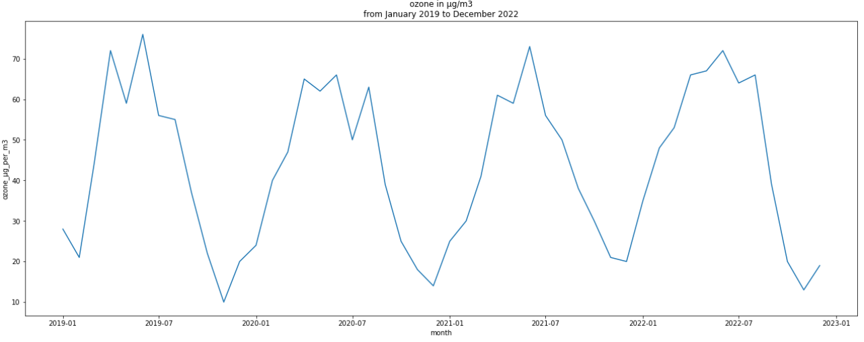
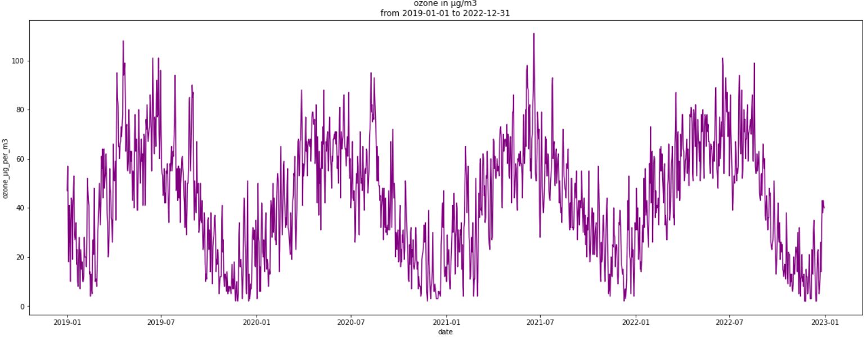

Ozone (O₃)
Notes:
Ozone is formed mainly during intensive solar radiation
the values have not decreased over the last 4 years

Slide 8

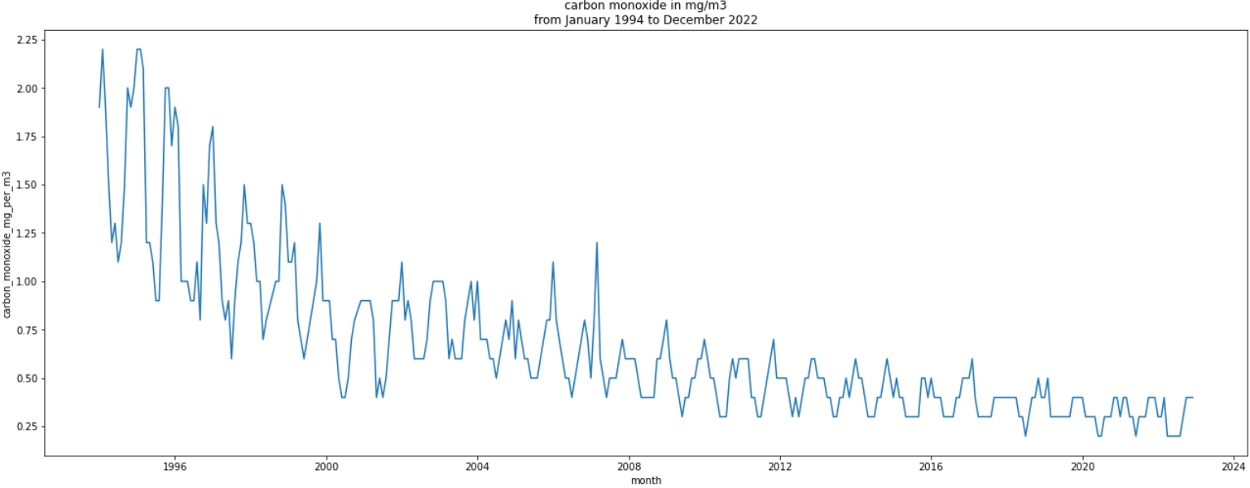
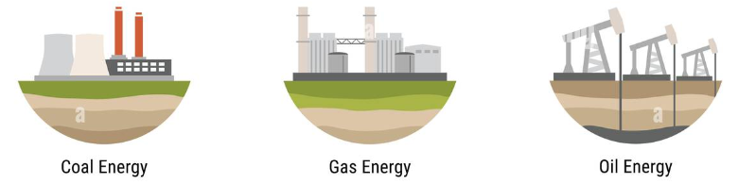
Carbon monoxide (CO)?
Notes:
We can see, that carbon monoxide emissions have fallen sharply in recent years

Slide 9
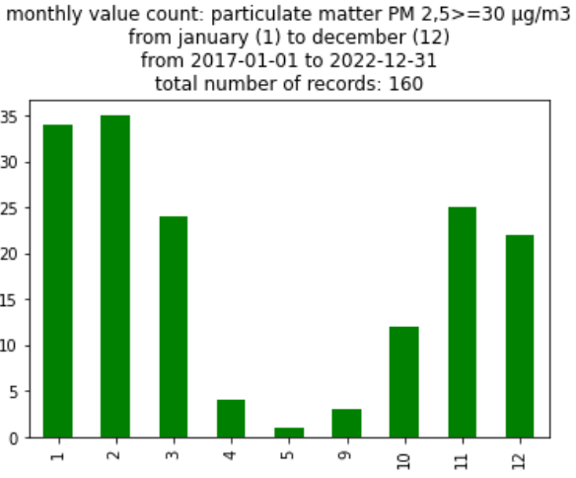


Results
Disclaimer!
In the following bar charts, readings are counted
when they are above a certain threshold.
Neither an average value nor a sum is displayed.

Slide 10
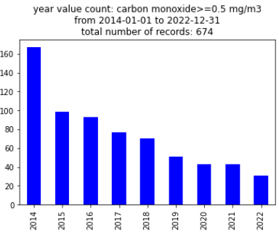
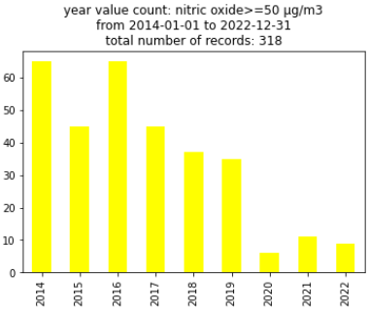
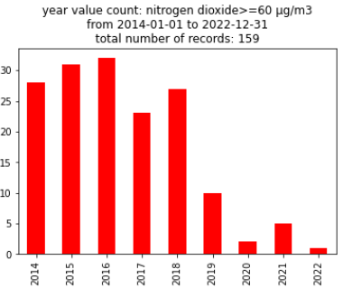
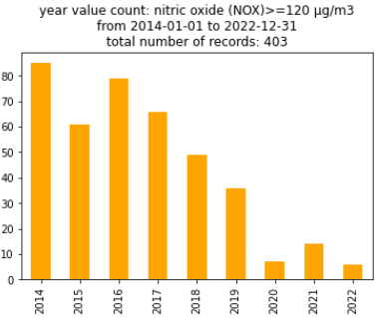

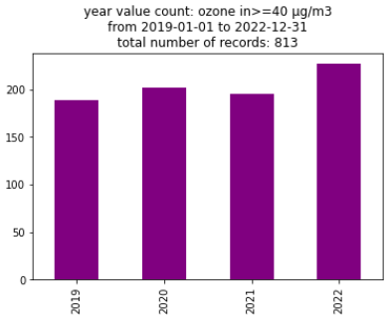
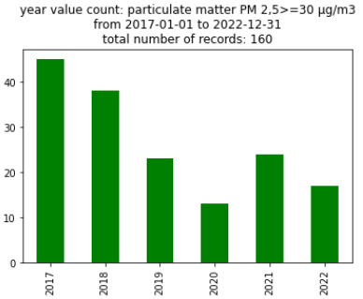
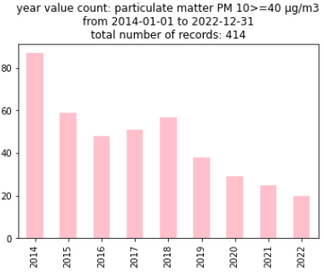
Years
CO
NO
NO₂
NO_{x}
High energy prices
High energy prices
High energy prices
O₃
PM2,5
PM10
Notes:
Positive trend…value counts are going down doe to political and individual measures to reduce CO₂ and air pollution
Ozone is formed mainly during intensive solar radiation

Slide 11
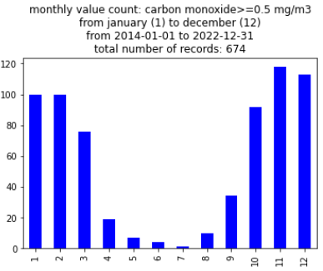
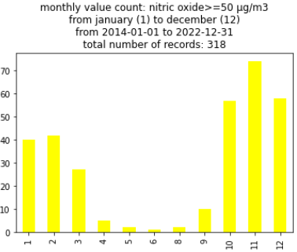
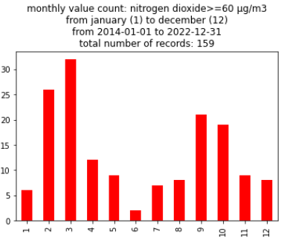
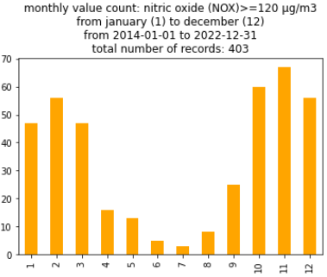
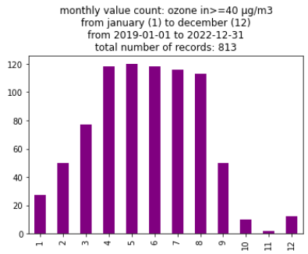
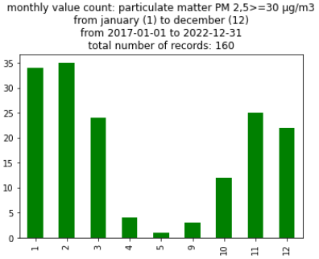
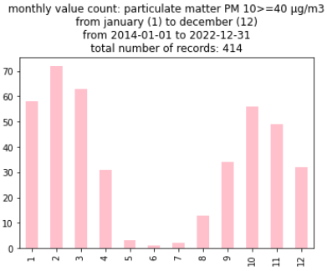
Month
CO
NO
NO₂
NO_{x}
O₃
PM2,5
PM10
Heating?
Notes:
with ozone it is reversed due to the influence of solar radiation

Slide 12
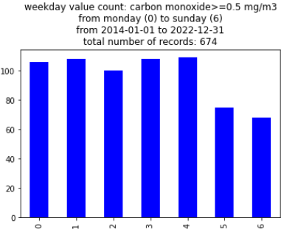
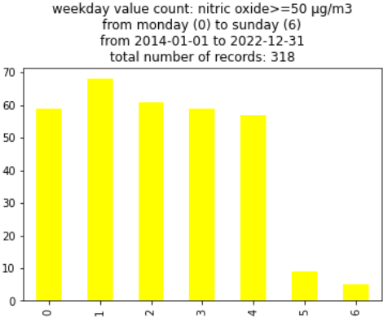
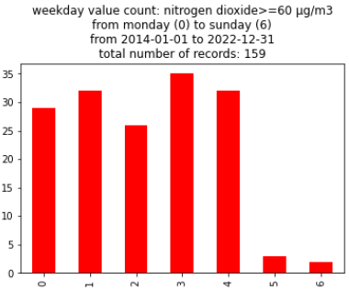
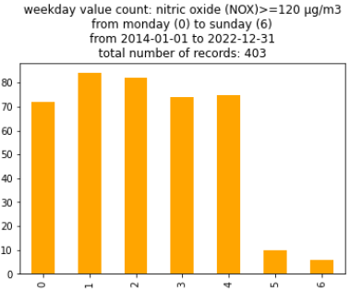
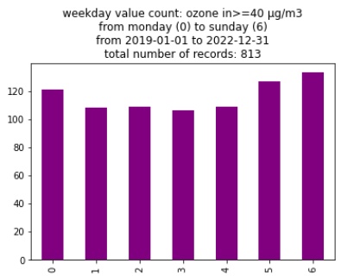
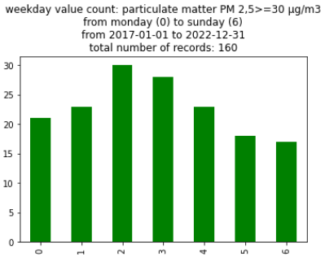
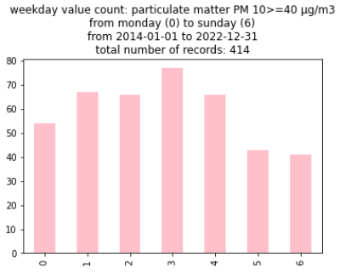
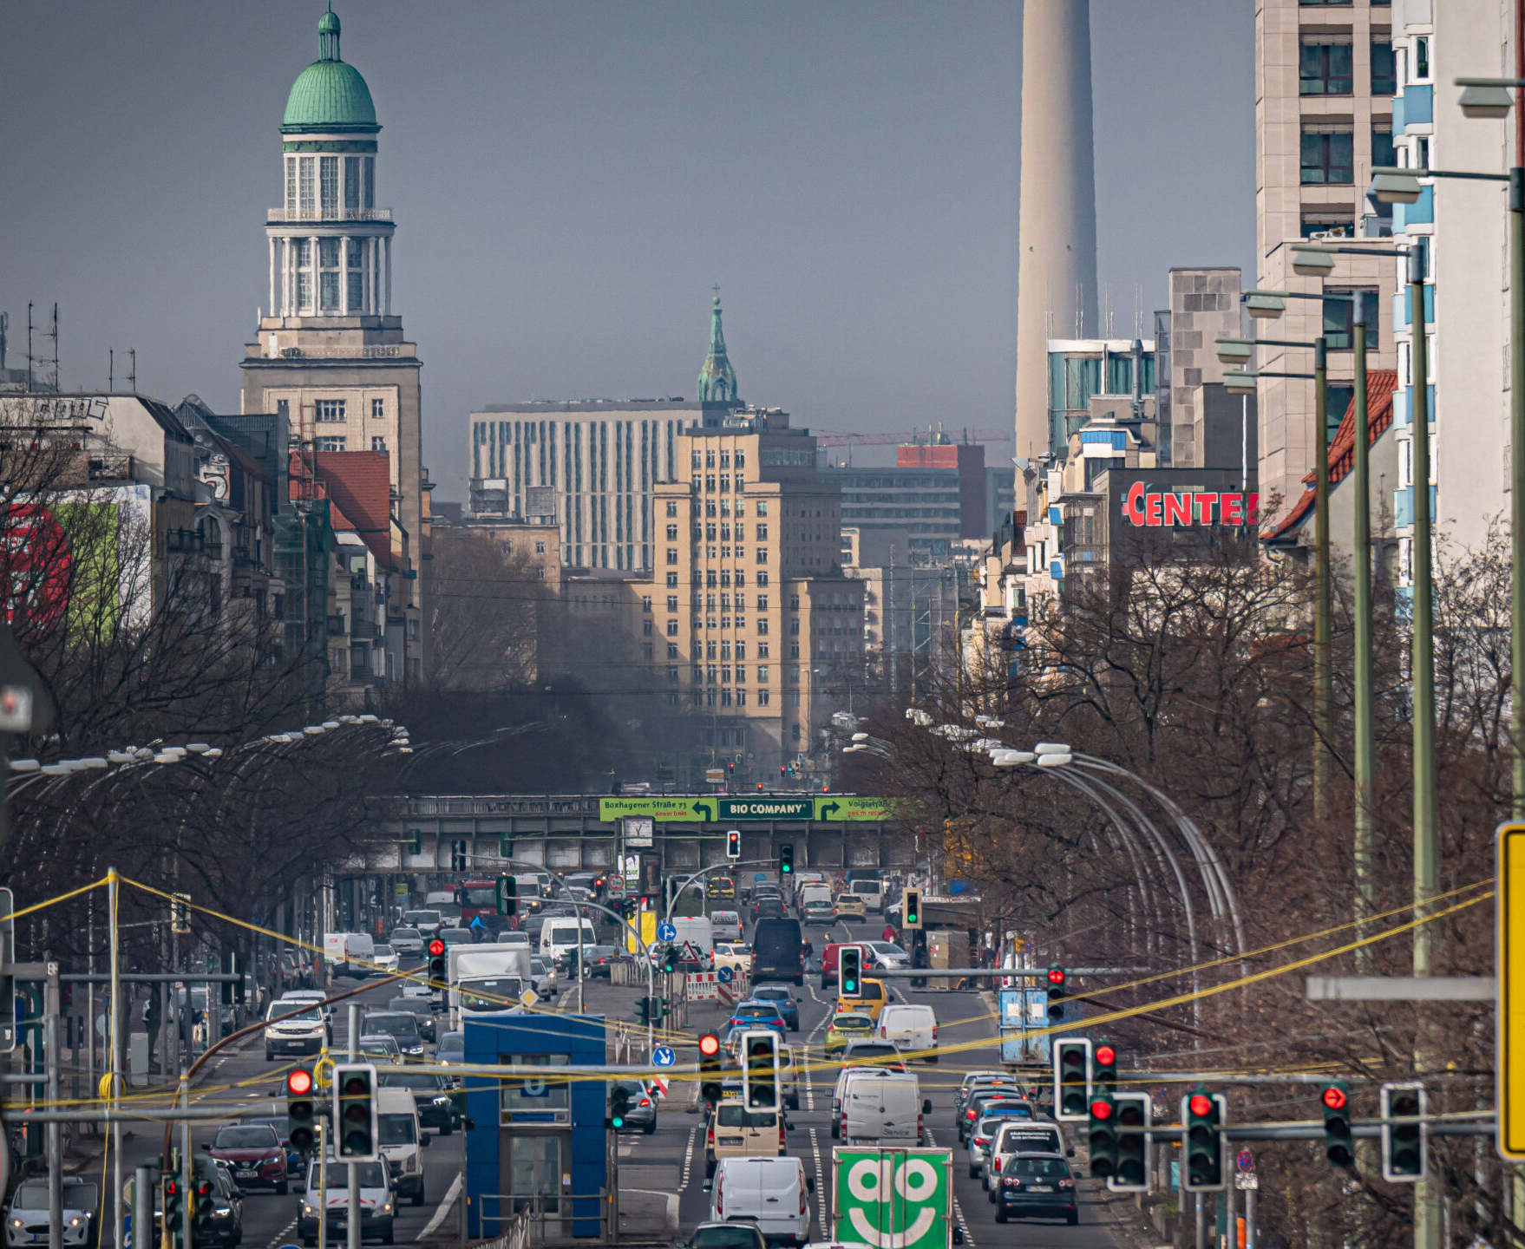
Weekdays
CO
NO
NO₂
NO_{x}
O₃
PM2,5
PM10
Driving?

Slide 13
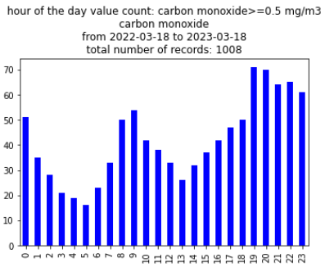
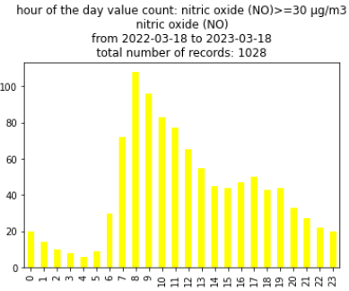
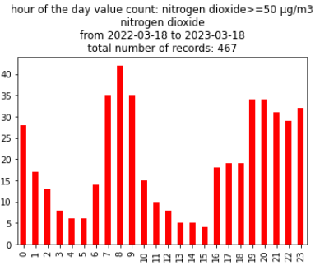
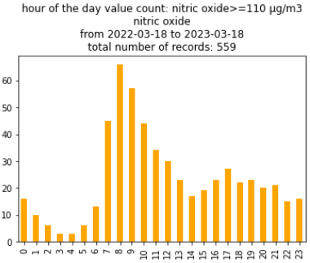
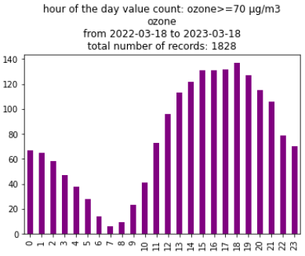
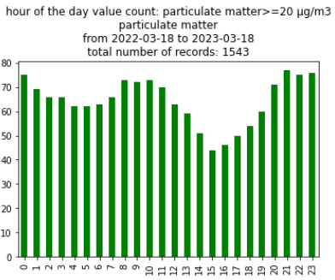
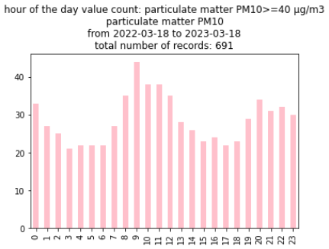
Hour of day
CO
NO
NO₂
NO_{x}
O₃
PM2,5
PM10
Driving+Heating?
Notes:
Sinus curve shape according to the position of the sun

Slide 14

Thank you for listening! Any questions?
40 / 5.000
Übersetzungsergebnisse
Übersetzung
Thank you for listening! Any questions?
Notes:
I'm open for questions

Slide 15
droped:
40 / 5.000
Übersetzungsergebnisse
Übersetzung
Thank you for listening! Any questions?
Notes:
I'm open for questions

Slide 16
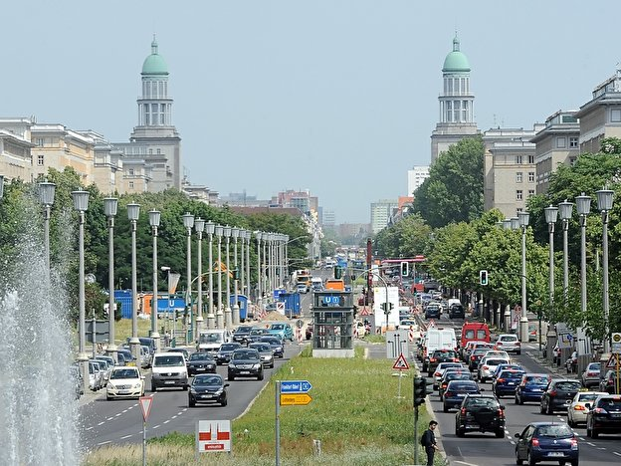
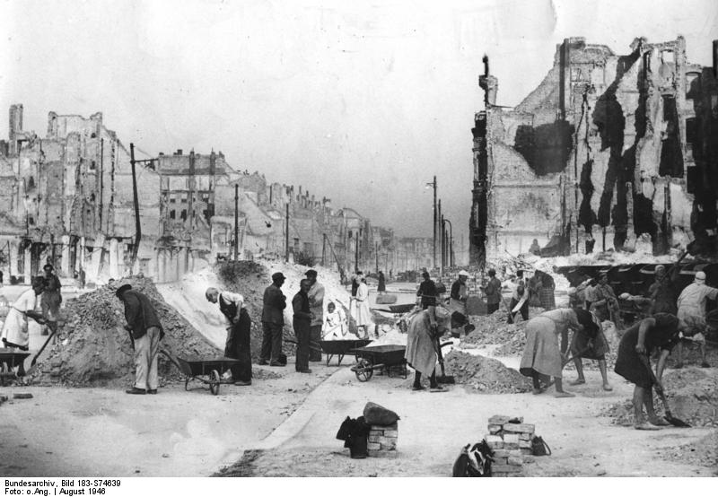
During the Battle of Berlin in April 1945, the street was one of the main routes the Red Army used to advance into the government district around Wilhelmstrasse and the Reichstag.
The Frankfurter Allee is one of the oldest roads of Berlin (1708). It extends the Karl-Marx-Allee from Frankfurter Tor in the direction of the city of Frankfurt (Oder). It is part of Bundesstraße 1 and has a length of 3.6 kilometres (2.2 mi).

Slide 17
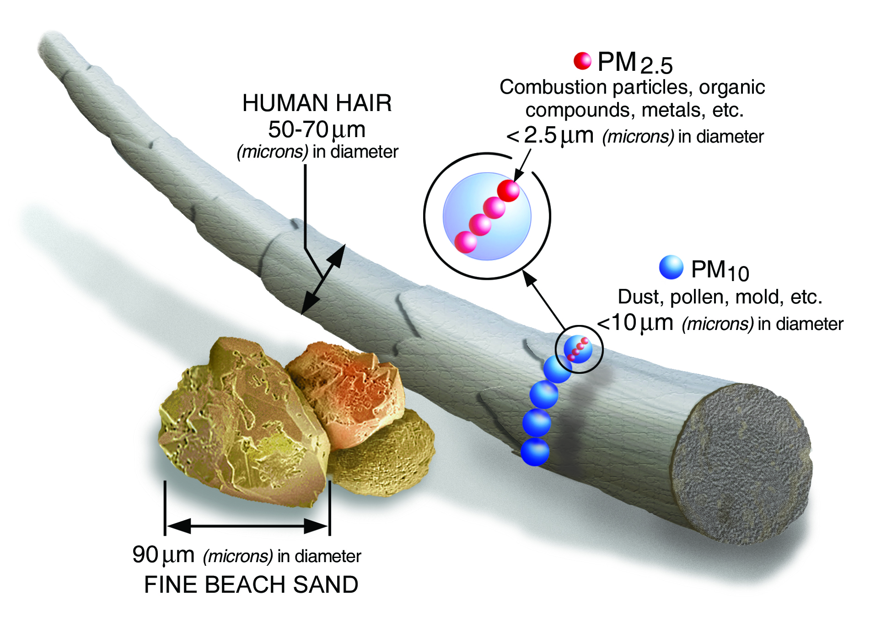
Particulate air pollutants - Particulate Matter (PM)
Notes:
Some particles, such as dust, dirt or smoke are large or dark enough to be seen with the naked eye and are small enough to be breathable
PM₁₀ : generally diameters 10 micrometers and smaller
PM_{2.5} : generally diameters 2.5 micrometers and smaller.

Slide 18
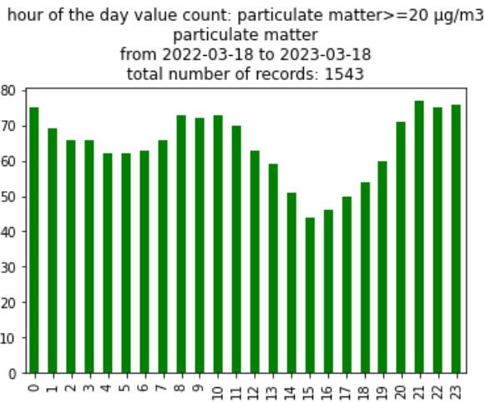
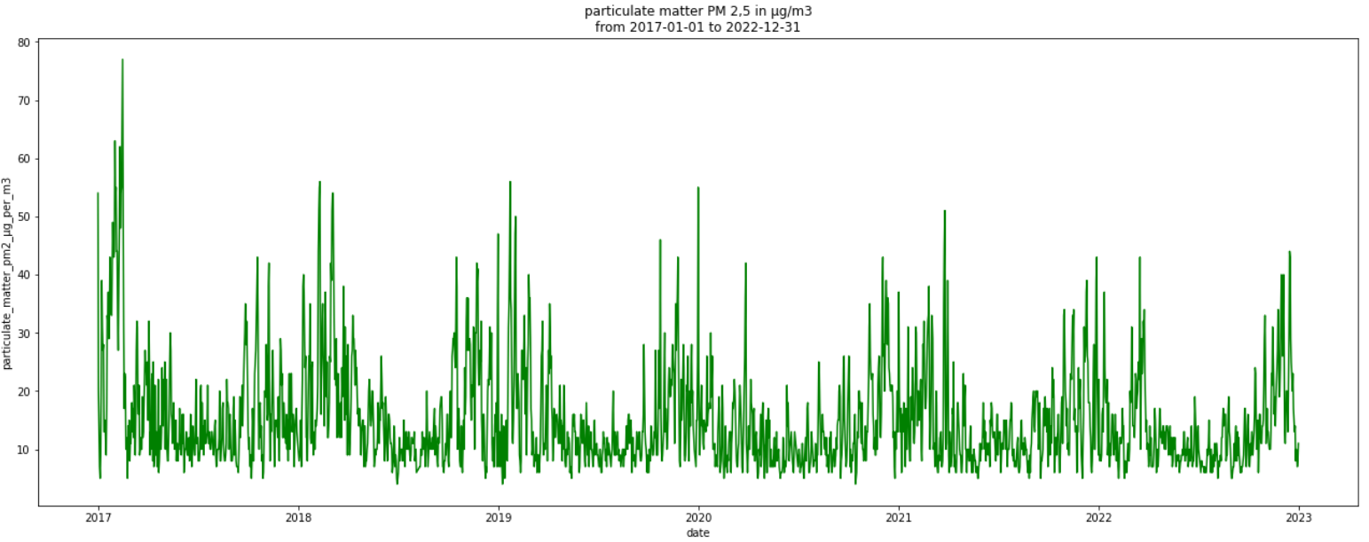
PM2,5

Slide 19



PM10

Slide 20


PM2,5
PM10

Slide 21






NO
NO₂
NO_{x}
day
year

Slide 22

NO
NO₂
1994-2022
2014-2022
NO_{x}
NO+NO₂ =NO_{x}
1994-2022
A week in May 2022
Notes:
you can clearly see that the values have decreased over the years
here you can see how NO and NO2 add up to NOX...
the next gas we consider is ozone

Slide 23


Slide 24




(O₃)

Slide 25
Ozone (O₃)
Notes:
distinct pattern
the next gas we consider carbon monoxide

Slide 26


What is Ozone (O₃)?
The colorless and toxic gas ozone is one of the most important trace gases in the atmosphere. The natural ozone layer, which is 20 to 30 kilometers high in the atmosphere, protects the earth from the sun's harmful ultraviolet radiation.
Ozone occurring near the ground is not released directly, but is formed from precursor pollutants − mainly nitrogen oxides and volatile organic compounds − during intensive solar radiation by complex photochemical processes.

Slide 27




(CO)

Slide 28
Particulate air pollutants
Some particles, such as dust, dirt, soot, or smoke, are large or dark enough to be seen with the naked eye.
PM₁₀ : inhalable particles, with diameters that are generally 10 micrometers and smaller; and
PM_{2.5} : fine inhalable particles, with diameters that are generally 2.5 micrometers and smaller.

Slide 29



What is Nitrogen Dioxide (NO₂ )?
Nitrogen Dioxide (NO₂) is one of a group of highly reactive gases.
NO₂ primarily gets in the air from the burning of fuel. NO₂ forms from emissions from cars, trucks and buses, power plants, and off-road equipment.
What is nitric oxide (NO)?
Nitric oxide appears as a colorless gas. Noncombustible but accelerates the burning of combustible material. Vapors heavier than air. Very toxic by inhalation and skin absorption.
What are nitrogen oxides (NOₓ)?
Nitrogen oxides (NOₓ), mainly a mixture of nitric oxide (NO) and nitrogen dioxide (NO2), are formed by the reaction of nitrogen and oxygen compounds in the air as a result of combustion processes and traffic.

Slide 30
What is carbon monoxide (CO)?
The most common source of carbon monoxide is the partial combustion of carbon-containing compounds.
The greatest sources of CO to outdoor air are cars, trucks and other vehicles or machinery that burn fossil fuels. A variety of items in your home such as unvented kerosene and gas space heaters, leaking chimneys and furnaces, and gas stoves also release CO and can affect air quality indoors.

Slide 31

Station #174 Frankfurter Allee
What is measured?
Particulate Matter (PM10)
Particulate Matter (PM2.5)
Nitrogen Dioxide (NO₂)
Nitric Oxide (NO)
Total Nitrogen Oxides (NOₓ)
Ozone (O₃)
Carbon Monoxide (CO)
Sulfur Dioxide (SO₂)
available measurement intervals:
Hour
Day
Month
Year

